Slide 1
Object Oriented Programming Project
C++ Programming

Slide 2
Bank Account Management System
Submitted by-
Archit Sarkar - 172
Aayushi Singh - 166
Pranay Kumar - 177
Pritom Mukherjee - 181

Slide 3
01
Overview
In the current program, we will be operating a source code having various classes and functions and with the help of that, we will be able to perform changes such as creation, updation and deletion of bank accounts with user inputs.

Slide 4
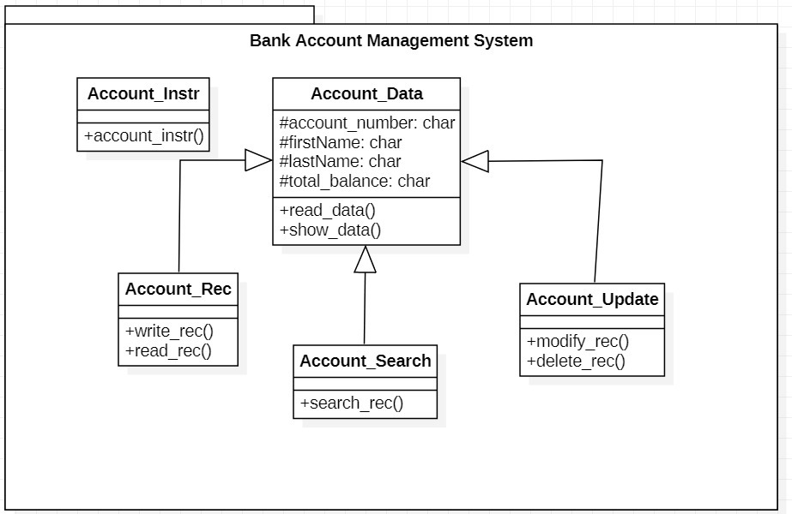
Class Diagram
KEYS
KEYS
KEYS

Slide 5
Operations performed :-
1. READ
2. WRITE
3. SEARCH
4. MODIFY

Slide 6
Write Operation :-
Declare class ofstream and create object fout .
Open record.txt file in append mode . By opening in append mode the previous datas wont delete.
Check for error.
Call read_data() function declared in Account_data class.
The fout.write will write the entered data in record file.
After writing the data in the file, close the file using fout.close().

Slide 7
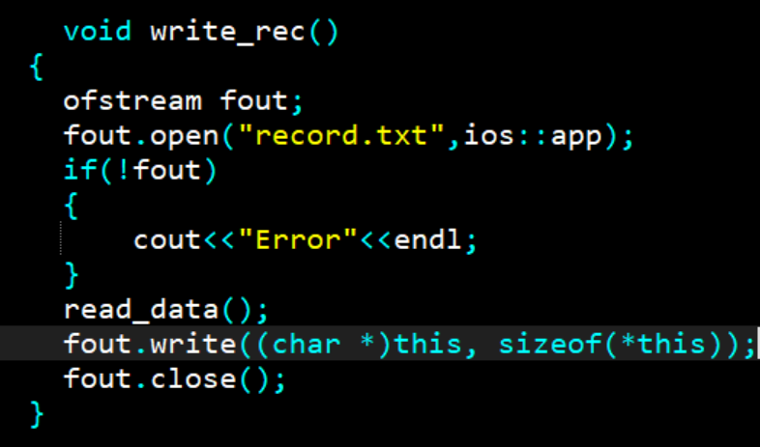
fin.read((char*)(this), sizeof(*this)) is a function statement that is mostly used to read and write the data to the data file. Here the this * refers to the read_data() function.
sizeof(*this) - yields the size of the function that we are referring .

Slide 8
Read Operation :-
Declare class ifstream and create object fin .
Open record.txt file in append mode . By opening in append mode the previous datas wont delete.
Check for error.
Read the datas present in the file in the output screen till the end of file [fin.eof()] is reached.
Call show_data(). Datas are shown on screen till the end of file.
After reading the data from the file, close the file using fin.close().

Slide 9
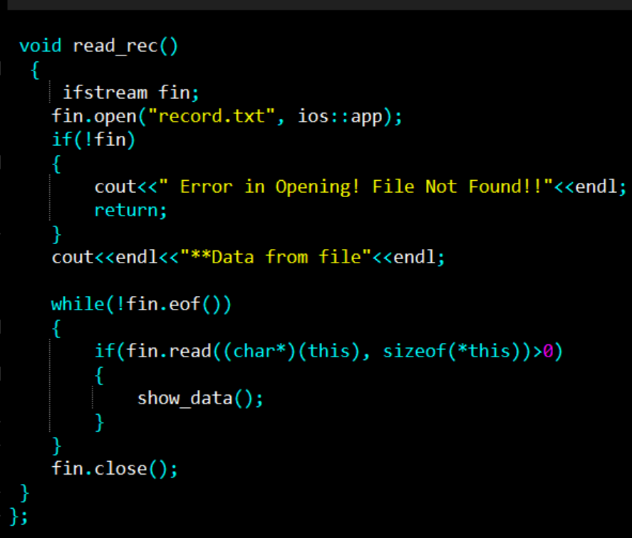
fin.read((char*)(this), sizeof(*this)) is a function statement that is mostly used to read and write the data to the data file. Here the this * refers to the show_data() function.
sizeof(*this) - yields the size of the function that we are referring .

Slide 10
Search Operation :-
1.Declare class ifstream and create object fin.
2.Open record.txt file to read the data.
3.Check for error.
4.Using fin.seekg(0,ios::end) we traverse the get pointer to the end
Of the file.
5.Fin.tellg()/sizeof(*this) is being used to count the number of records
in the file.
6.Enter record number to be searched(n).
7.Use seekg((n-1)*sizeof(*this)) to find the particular record.
8.Read the data from the file using read().

Slide 11
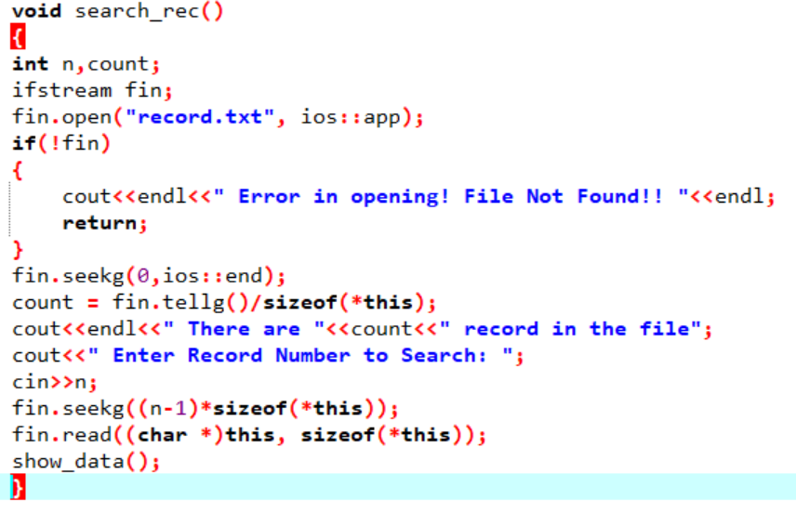

Slide 12
1.Declare class fstream and create the object iofile.
2.Open Record.txt file to read the data in ate mode.
3.Check for error.
4.iofile.seekg(0,ios::end) is being used to traverse the get pointer to the end
of the file.
5.iofile.tellg()/sizeof(*this) has been used to count the number of records
in the file.
6.The record number to be edited (n) is being entered.
7.Use iofile.seekg((n-1)*sizeof(*this)) to find the particular record.
8.Read the the data from the file using read().
9.show_data() is used to display the data.
10.iofile.close() is used to close the file.
11.Again, Record.txt file is opened in ate mode.
12.Use iofile.seekp((n-1)*sizeof(*this)) to find the particular record.
13.read_data() is again used to enter the data.
14.iofile.write((char*)this,sizeof(*this)) is used to modify/update data in the file.
Modify Operation :-

Slide 13
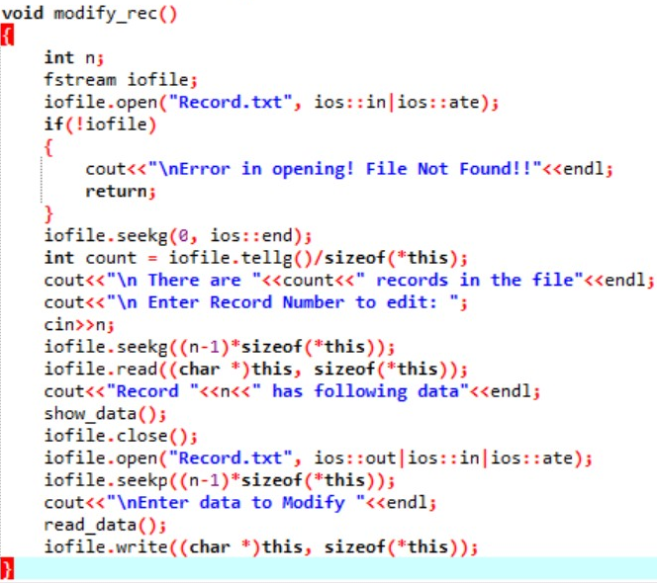

Slide 14
1.Declare class ifstream and create object fin.
2.Open record.txt file using fin. open in append mode.
3.Check for error.
4.fin.seekg(0, ios::end) is being used to traverse the get pointer to the end
of the file.
5.fin.tellg()/sizeof(*this) is being used to count the number of records in the file. Number of records is initialized to variable count.
6.Enter the record number.
7.Declare class fstream and create object tmpfile.
8.Open Tmpfile.txt file using tmpfile.open.
9.Copy all the data present in the record.txt file in the Tmpfile.txt file leaving the one that we intend to delete.
10.Close both record.txt and Tmpfile.txt file.
11.Remove record.txt file and rename Tmpfile.txt file as record.txt file.
Delete Operation :-

Slide 15
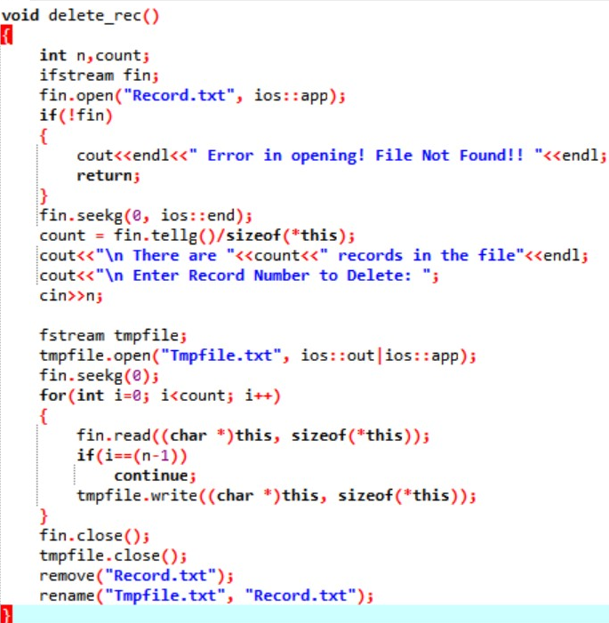

Slide 16
Execution

Slide 17
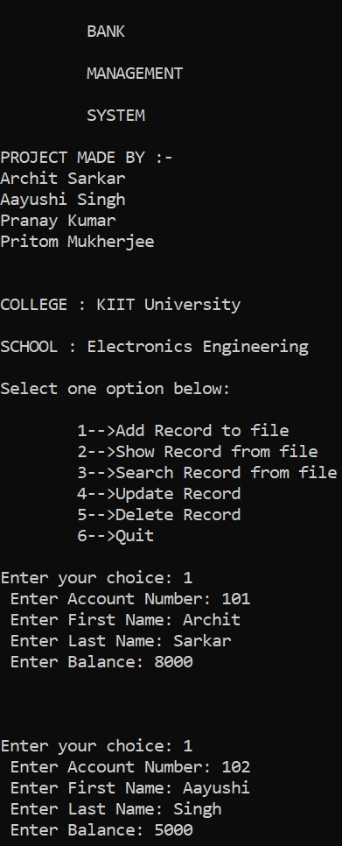
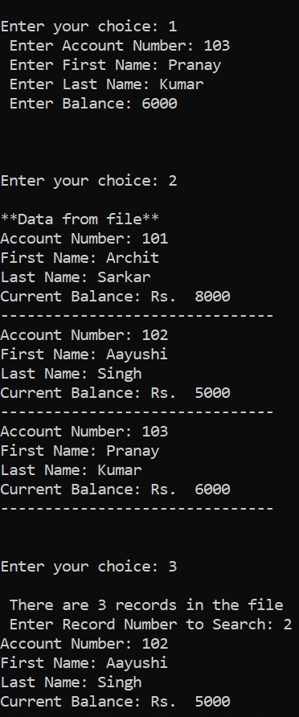

Slide 18
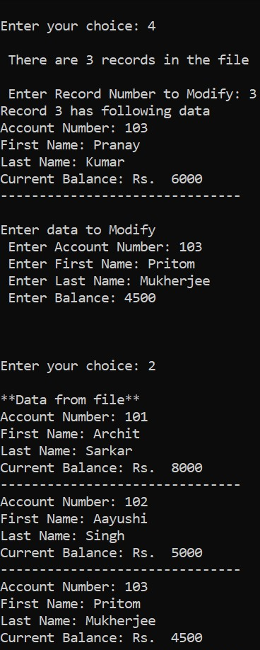
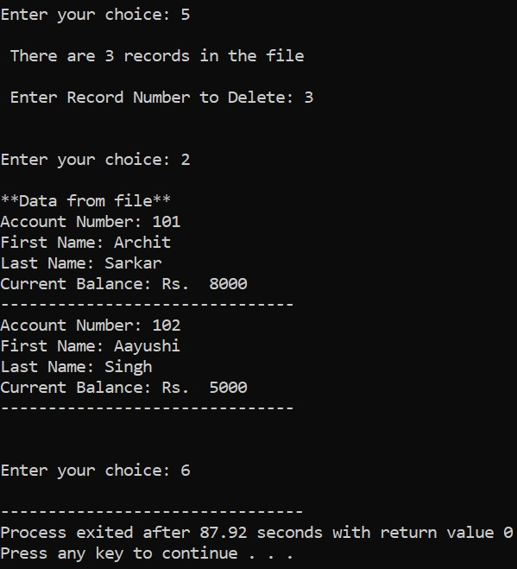

Slide 19


